Slide 1
ECE408 midterm Review
Jianli Jin, Jiatong Li

Slide 2
About GPU architecture
GPU focus on High throughput and fight against latency with massive number of threads.
SPMD stands for Single Program, Multiple data.
Load Balance: Parallel jobs wait for the slowest thread to finish
Global Memory Bandwidth: Low, avoid frequently transferring data. Save data in shared mem.
CPU vs GPU
 | Clock Freq | Caches | Control | ALU (Arithmetic Logical Unit)
CPU | High | Large | Sophisticated | Powerful
GPU | Moderate | Small | Simple | Energy Efficient

Slide 3
All threads in a block execute the same kernel program. Single Program, Multiple data
Threads in the same block share data and synchronize while doing their share of the work
Threads in different blocks cannot cooperate
• Blocks execute in arbitrary order!
In CUDA programming, barrier synchronization is block-wise. This is implemented using the `__syncthreads()` function in CUDA. This function is a barrier where all threads within the same block must reach this point before any can proceed.

Slide 4
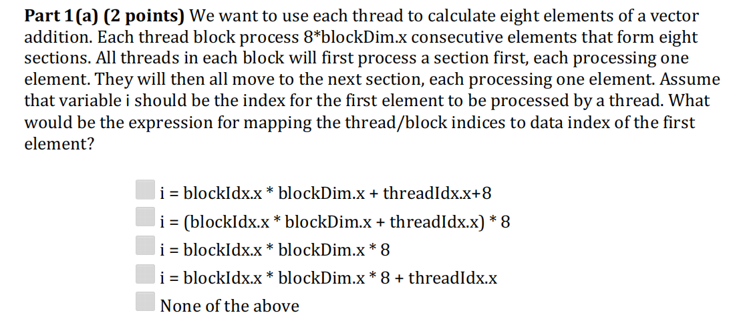

Slide 5
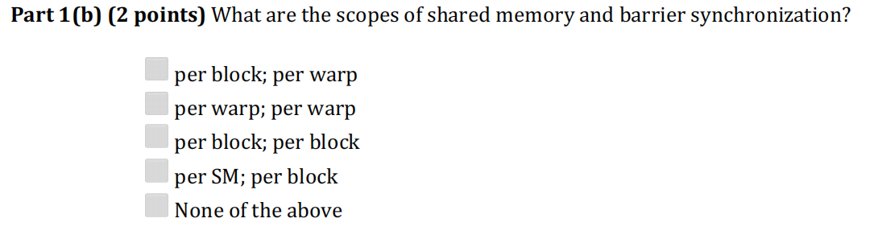

Slide 6
Memory burst
When threads in a warp (a group of 32 threads) access consecutive global memory locations, the hardware can coalesce these accesses into a single memory transaction, also known as a memory burst.

Slide 7
2. 3D convolution bandwidth reduction
Given kernel size 5*5*5, output size should be 20*20*20, block size is 10*10*10, input size is also 20*20*20. What is the global bandwidth reduction if we apply shared tile comparing to simple 3D convolution? Assume shared tile size is the same as block size Step by step:
1. how many times we read from global memory using simple 3D convolution?
For each output element, we load 5*5*5 data, so the total is 5*5*5*20*20*20, but we need to consider those input that are halo.
2. how many times we read from global memory with shared tile strategy?
Treat internal blocks and other blocks differently.

Slide 8
JIANLI

Slide 9
2.1. CUDA Basic concepts
Mapping thread index into data index
Memory hierarchies – characteristics and usage of each type of memory CUDA APIs

Slide 10
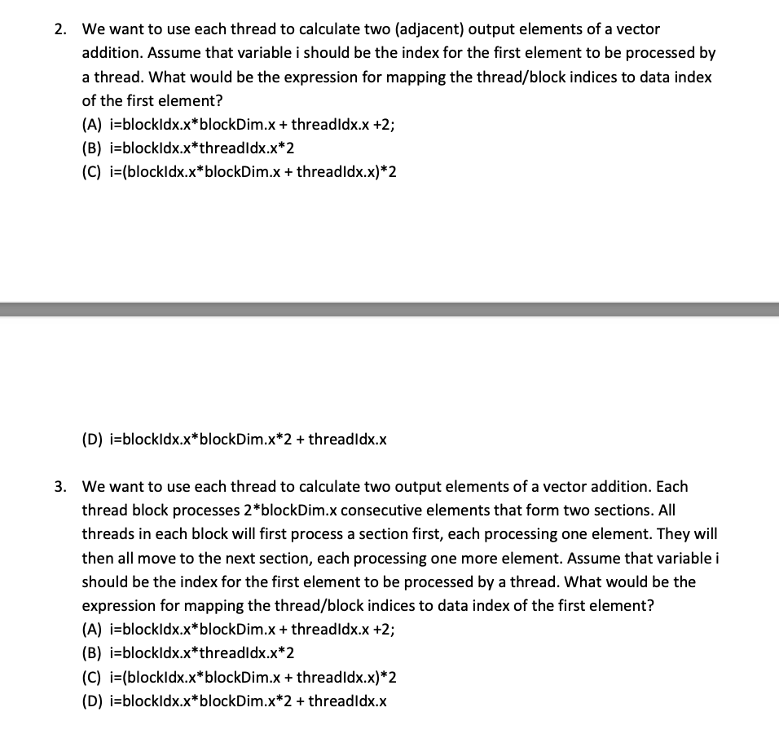
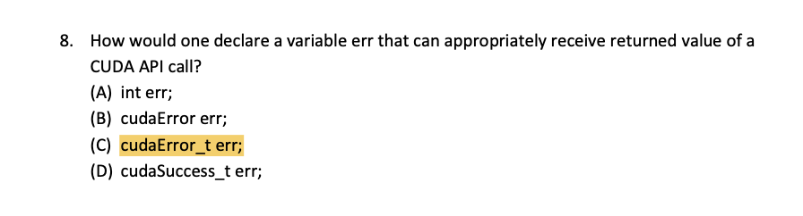

Slide 11
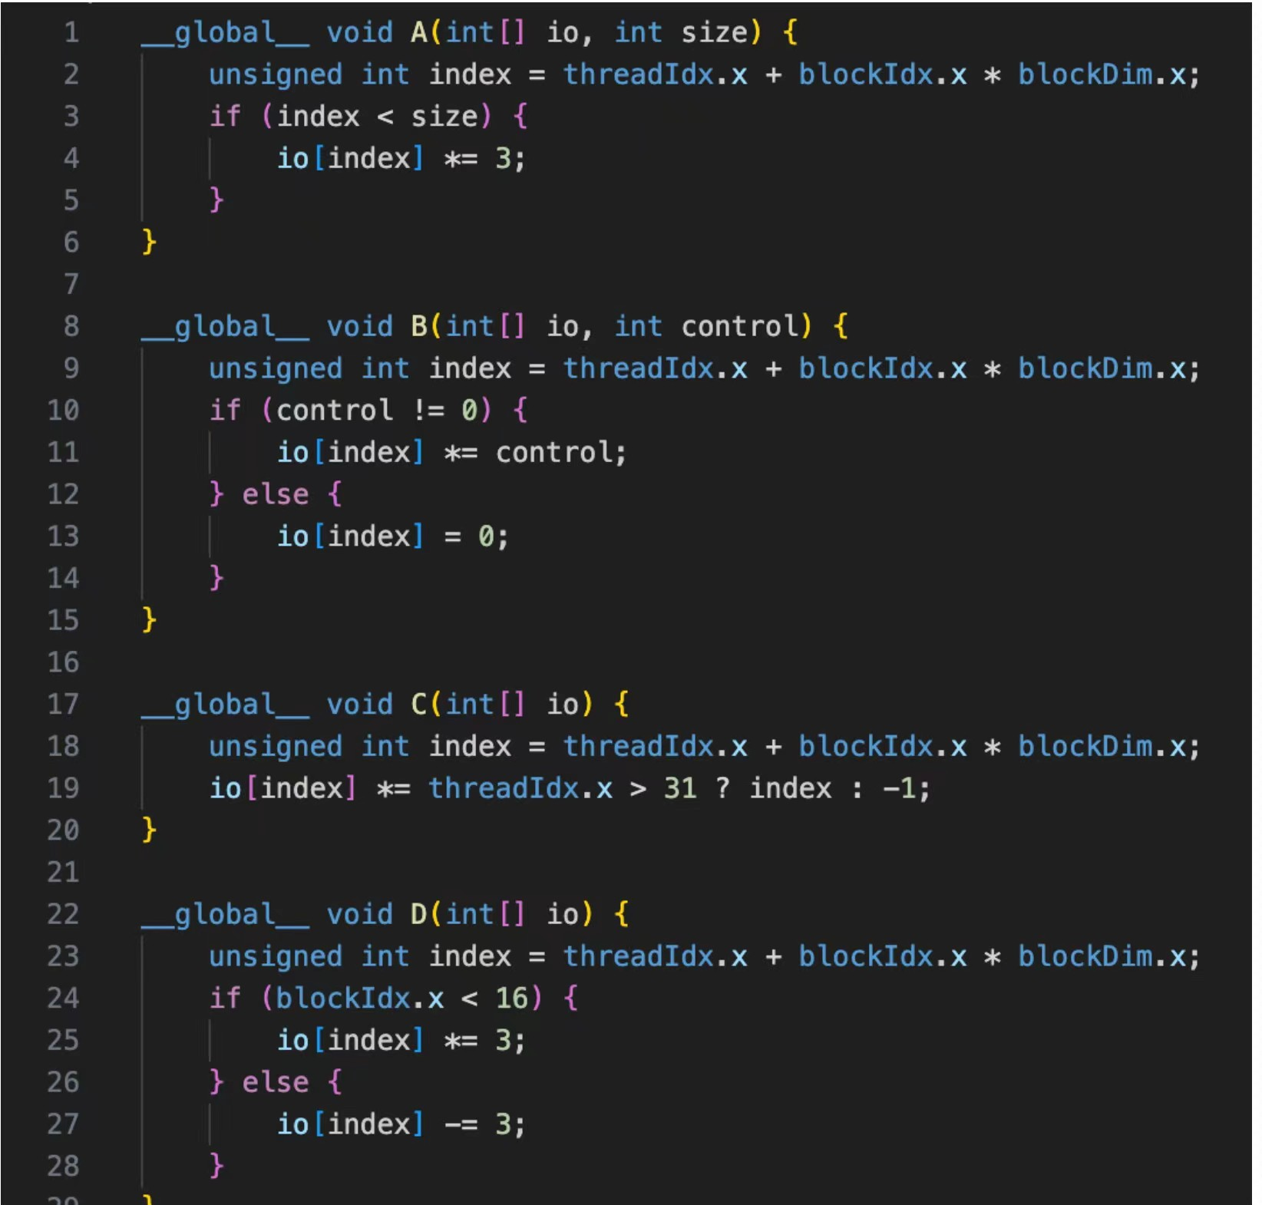
Blockdim.x=33, Blockdim.y=2

Slide 12
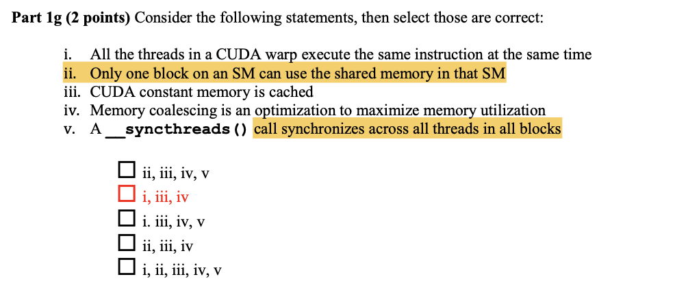
2.2. Parallel Kernel Execution Concepts
Using multi-dimensional thread indices to easily access multi-dimensional data
structures
Boundary condition checking and control divergence -----what is warp
Thread capacity and thread block capacity of Streaming Multiprocessor

Slide 13
2.3. Tiling
Proper use of CUDA shared memory
Explain the principles and scope of memory coalescing
Derive the necessary array indexing for a tiled matrix multiplication
Understand the use of barrier synchronization in a tiled algorithm
Estimate the reduction of memory bandwidth usage
Overhead due to halo cells in algorithms such as convolution
Understanding how to extend square tiles to rectangular tiles

Slide 14
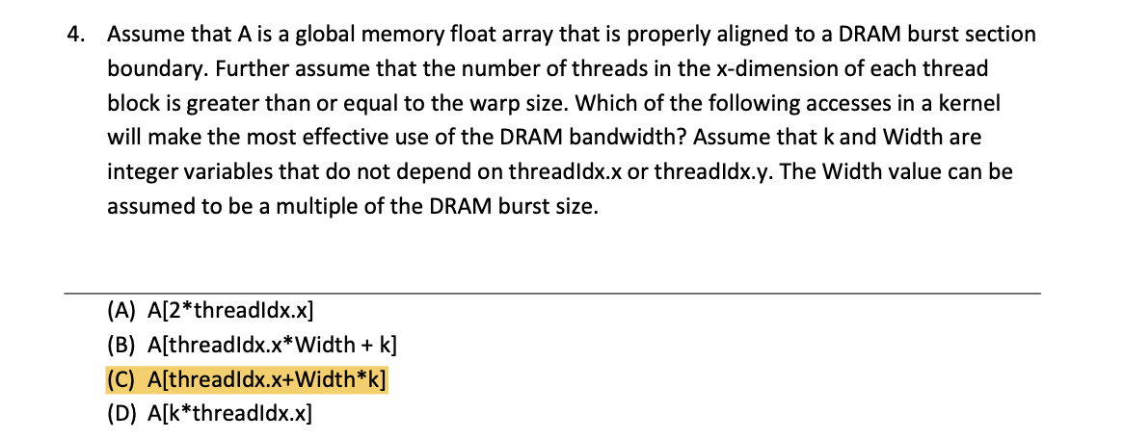
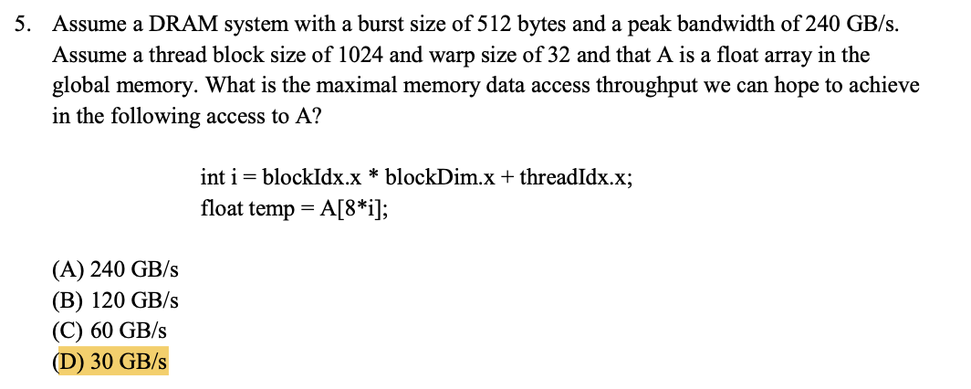
Basic coleasing & bandwidth calculation

Slide 15
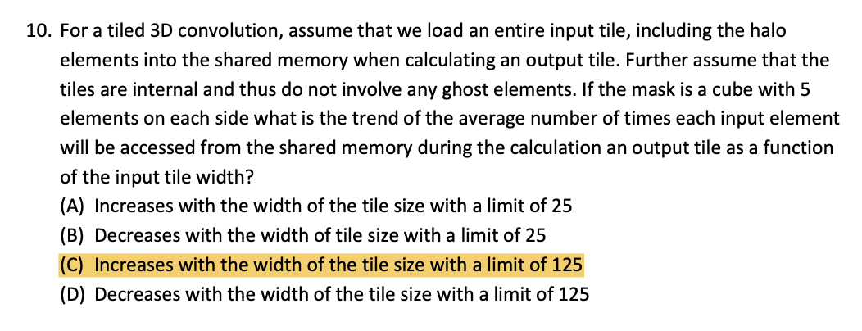
Conv: everage accessing

Slide 17
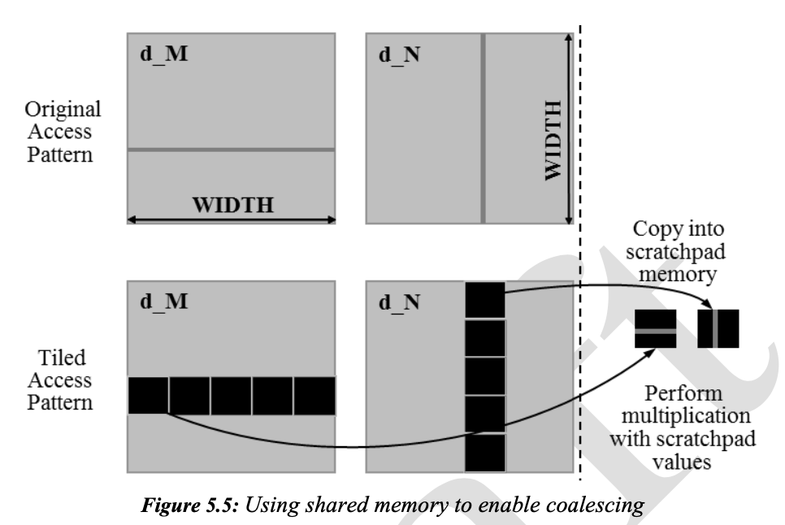
“corner turning”

Slide 18
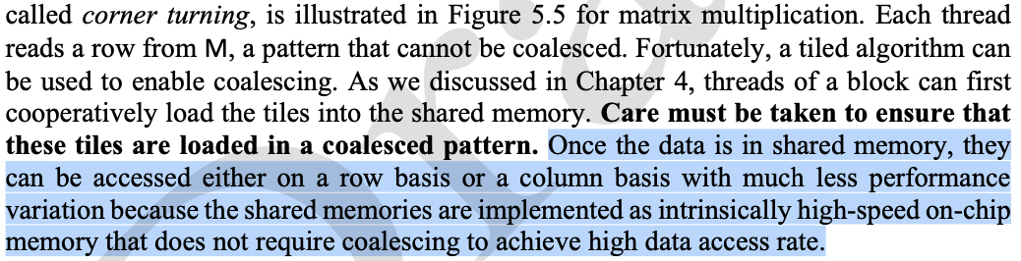
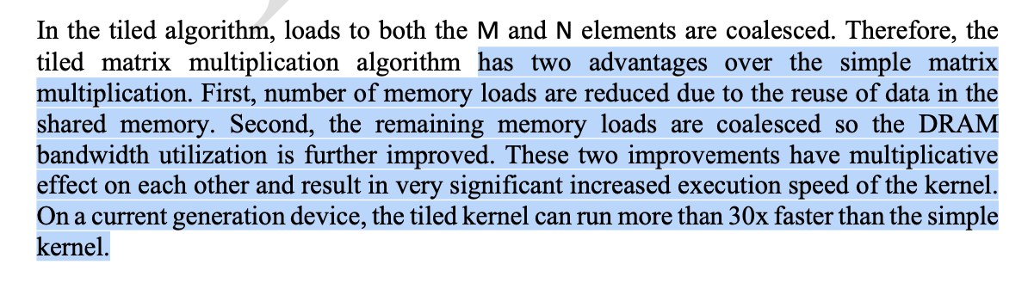

Slide 19
barrier synchronization
For a1,b1,a2,b2......
Σmax{ai,bi}>=max{Σai,Σbi}
Less barrier, better....

Slide 20
ECE408_Exam_1_Study_Guide_2019_v7
LAB Q3
Square & rectangular tile....
Numbers of memory accessing times....
Numbers of bursts.....
Pros & cons.....

Slide 21
By the way....Strategy 3 to 2? (show the pro&con)
Pros:
Simple input tile loading code
Better thread utilization
Simple output element writing code
Cons:
More complex calculation code
More global memory accesses
…. Know exactly how strategy 2 works..... and know codes of 1 &3

Slide 22
Compact "tiles":
ECE408_SP19_Exam1 Problem2

Slide 23
Some "tricky & smart" Problems
Separable 2D Convolution

Slide 24
3.machine learning
Detailedly see the transformation of conv to multiplication...
Most important things....

